Slide 1


NEXT GEN EMPLOYABILITY PROGRAM
CREATING A FUTURE-READY WORKFORCE
Student Name :
Harshal S. Ninawe
College Name :
AICTE Student ID :
STU66a3fb2277da21722022690
G H Raisoni College of Engineering and Management, Nagpur

Slide 2
CAPSTONE PROJECT SHOWCASE
Project Title
Recipe Sharing Platform with React and ExpressJS Framework
Abstract | Problem Statement | Project Overview | Proposed Solution | Technology Used | Modelling & Results | Conclusion | Q&A

Slide 3
Abstract
1
The Recipe Sharing Platform is a web-based application that allows users to share, explore, and manage recipes easily.
2
It features a user-friendly interface with seamless frontend and backend integration for a smooth experience.
3
Built using React.js, Node.js, Express.js, and MongoDB, the platform enables recipe uploads, browsing, and filtering.
4
The project aims to enhance digital recipe management and provide a community-driven space for food enthusiasts.

Slide 4


Problem Statement
Finding and sharing recipes online can be frustrating due to complicated platforms, limited search options, and paid subscriptions. Many existing sites lack a simple, user-friendly space where anyone—from home cooks to professional chefs—can easily upload, browse, and discover new recipes. This project aims to solve that by creating an intuitive, interactive, and free-to-use recipe-sharing platform for everyone.

Slide 5

Project Overview
The Recipe Sharing Platform is a web-based application that allows users to upload, browse, and manage recipes effortlessly.
Users can create an account, share their favorite recipes, and explore a wide range of dishes from different cuisines.
The platform provides search and filtering options to help users find recipes based on ingredients, categories, or dietary preferences.
Built with React.js (frontend), Node.js & Express.js (backend), and MongoDB (database) for a seamless and responsive experience.
The goal is to create an interactive and community-driven space for food lovers, making recipe sharing easy and accessible.

Slide 6
Proposed Solution
Develop a user-friendly and intuitive platform where users can easily share and explore recipes.
Implement advanced search and filtering options to help users quickly find recipes based on ingredients, cuisine, and preferences.
Ensure a seamless experience with a responsive UI, built using React.js for the frontend and Node.js with Express.js for the backend.
Use MongoDB for efficient data storage, enabling secure user authentication and recipe management.
Create an interactive and community-driven environment where users can engage, contribute, and discover diverse recipes effortlessly.

Slide 7
Technology used
Frontend: React.js – For building a dynamic and responsive user interface.
Backend: Node.js & Express.js – To handle server-side logic and API requests.
Database: MongoDB – For storing user data and recipe information efficiently.
Authentication: JWT (JSON Web Token) – To ensure secure user login and access.
Hosting & Deployment: GitHub, Vercel/Netlify (Frontend) & Render/Heroku (Backend)
Version Control: Git & GitHub – For collaborative development and code management.

Slide 8
Modelling
User Interaction
Frontend (React.js)
Backend (Node.js)
User visits the website
Can sign up or log in
Can browse or search for recipes
Displays recipes, forms, and interactive UI
Sends requests to the backend
Handles user authentication
Processes recipe data (add, edit, delete)
Fetches search results
Response Back to User
Database (MongoDB)
User gets search results or recipe details
Can interact with recipes
Stores user details and recipes
Manages recipe categories and filters

Slide 9
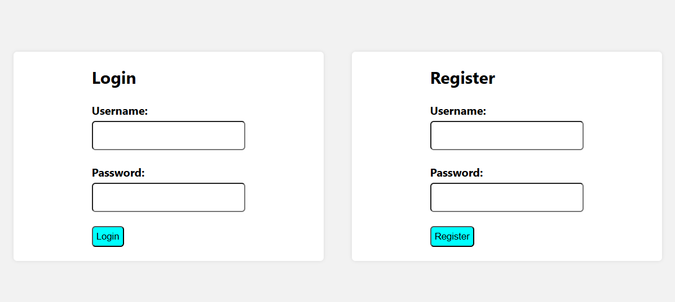
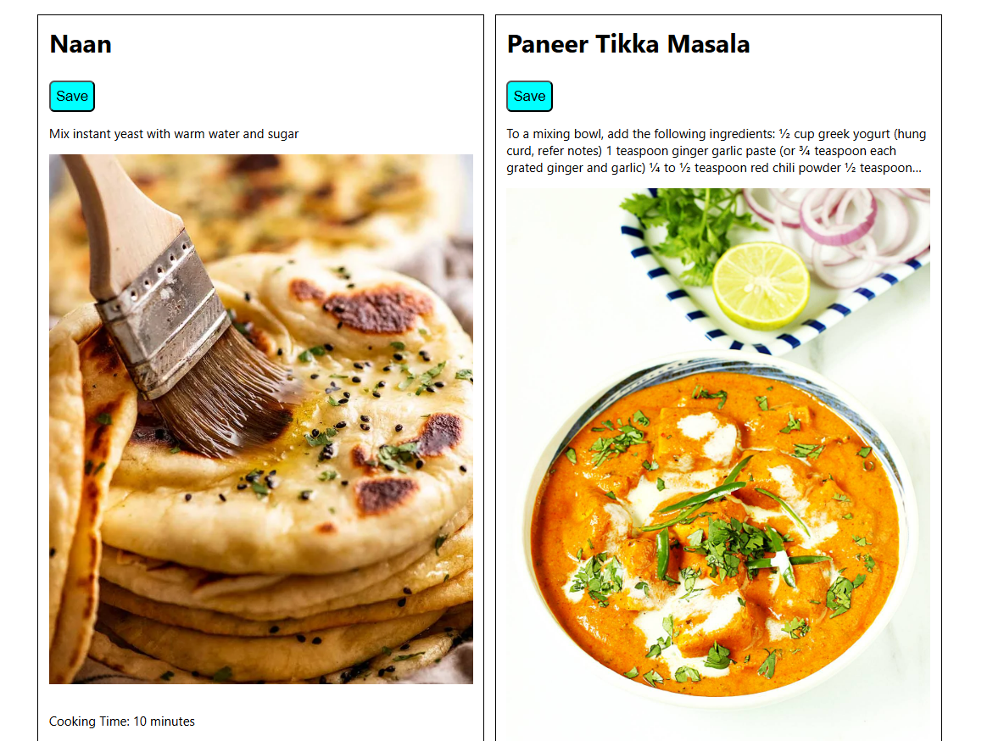
Result
Home Page
Login and Register Page

Slide 10
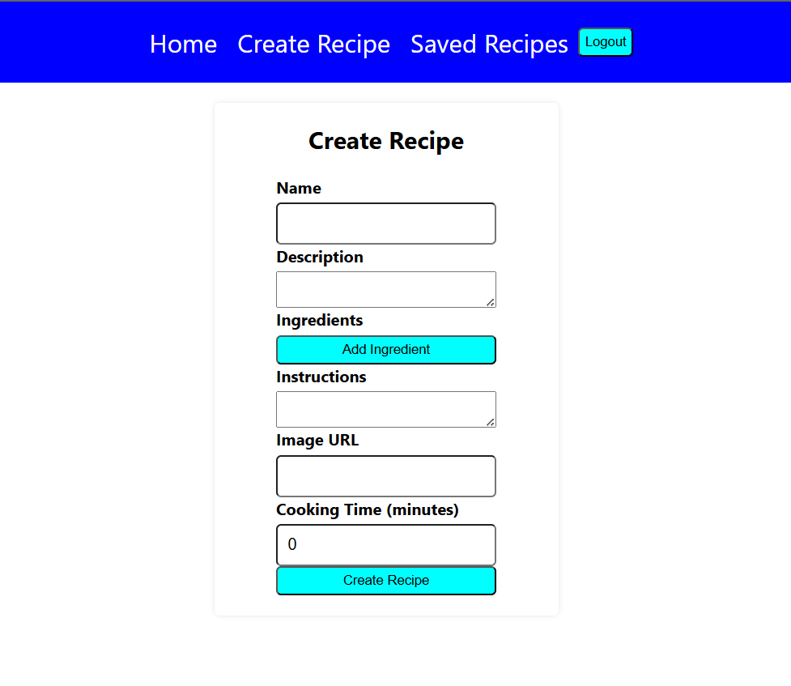
Result
Create Recipe Tab

Slide 11

Conclusion
The Recipe Sharing Platform provides an intuitive and interactive space for users to share, explore, and manage recipes seamlessly. Built using React.js, Node.js, Express.js, and MongoDB, the platform ensures smooth functionality, secure authentication, and an enhanced user experience. Through this project, I gained valuable hands-on experience in full-stack development, API integration, and database management, improving both my technical and problem-solving skills. In the future, the platform can be expanded with AI-based recipe recommendations, video tutorials, and a chat feature, making it even more engaging and user-friendly.

Slide 12


Notes:
Thank You !!

